Slide 1

Bulk Electronic Portfolio Management
Managing
Electronic
Resources
Yoel Kortick
Senior Librarian

Slide 2

Agenda
Introduction
The Electronic Service Editor “Portfolios” tab
Accessing the Electronic Service Editor “Portfolios” tab
Using the Electronic Service Editor “Portfolios” tab
  Move a set of portfolios
  Activate or deactivate multiple portfolios
The portfolio loader
  Using the portfolio loader to add new portfolios using an Excel sheet
  Using the portfolio loader to update portfolio coverage using a KBART file
The job “Change electronic portfolio information”

Slide 3
Introduction

Slide 4
Introduction
In this session we will focus on specific ways to update electronic portfolios in “Bulk” (or “Batch”).
We will use two methods:
  The “Portfolios” tab of the Electronic Service Editor (including the “Portfolio Loader”)
  The job “Change electronic portfolio information”
See also: Managing Electronic Resources

Slide 5
Introduction
Note that in order to manage electronic resources, you must have the following roles:
Electronic Inventory Operator = Manages the electronic inventory of the institution
Electronic Inventory Operator Extended = Extended management of the electronic inventory of the library - additional delete privilege. Should be used together with role "Electronic Inventory Operator".
Repository Manager = Manages authoritative inventory related actions

Slide 6



Introduction
These are the roles (where “Alma University” is the name of the institution)

Slide 7
The Electronic Service Editor “Portfolios” tab

Slide 8
The Electronic Service Editor “Portfolios” tab
The Electronic Service Editor “Portfolios” tab allows the staff user to perform a variety of functions in “batch” mode on portfolios. For example:
  Move a collection of portfolios from one electronic collection to another electronic collection
  Activate or deactivate all or specific selected portfolios in an electronic collection
  Delete all or specific selected portfolios in an electronic collection
  Add portfolios to an electronic collection from a set
  Load portfolios from a file (AKA “The Portfolio Loader”)

Slide 9
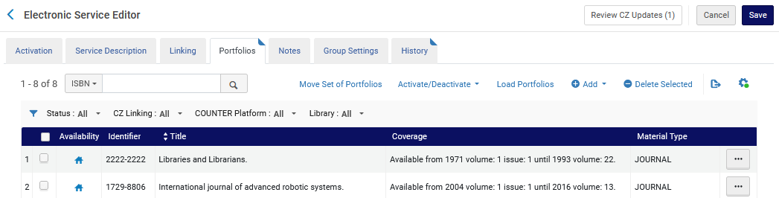
The Electronic Service Editor “Portfolios” tab

Slide 10
Accessing the Electronic Service Editor “Portfolios” tab

Slide 11
Accessing the Electronic Service Editor “Portfolios” tab
The Electronic Service Editor “Portfolios” tab can be accessed in two ways:
Option 1
  Search for electronic collection
  Click “action items” (the three dots next to the desired collection)
  Select “Edit Service”
  Switch to “Portfolios” tab
Option 2
  Search for electronic collection
  Edit the collection and arrive to the Electronic Collection Editor
  Switch to “Additional” tab
  Scroll to the bottom and click “action items” (the three dots) next to the service
  Select “Portfolios List”

Slide 12
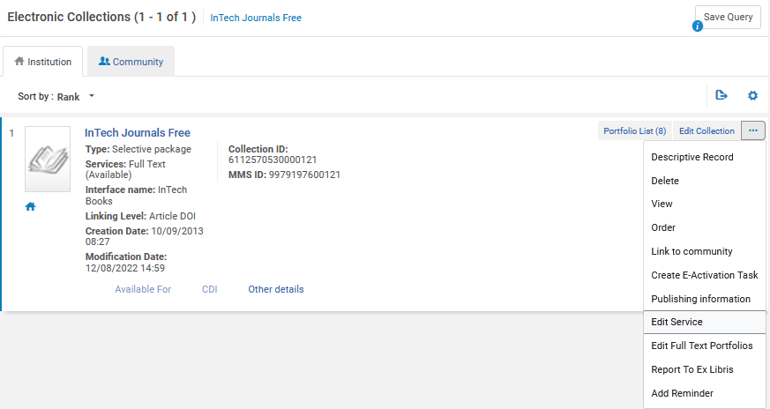
Accessing the Electronic Service Editor “Portfolios” tab
Option 1 – step 1

Slide 13
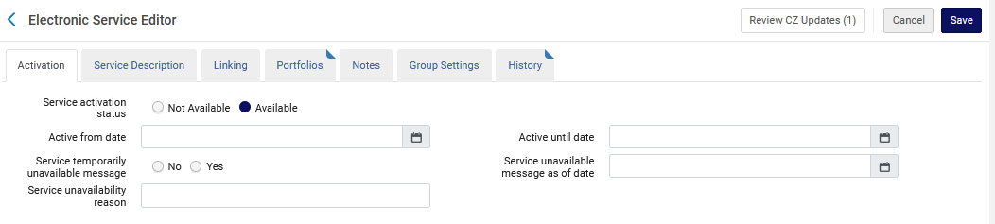
Accessing the Electronic Service Editor “Portfolios” tab
Option 1 – step 2

Slide 14
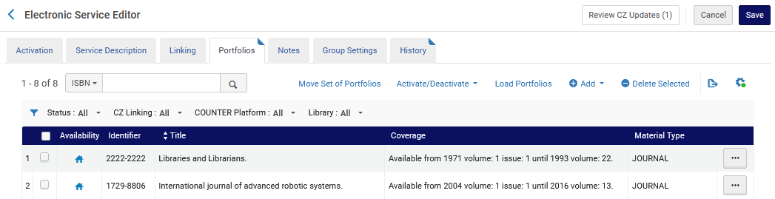
Accessing the Electronic Service Editor “Portfolios” tab
Option 1 – step 3

Slide 15
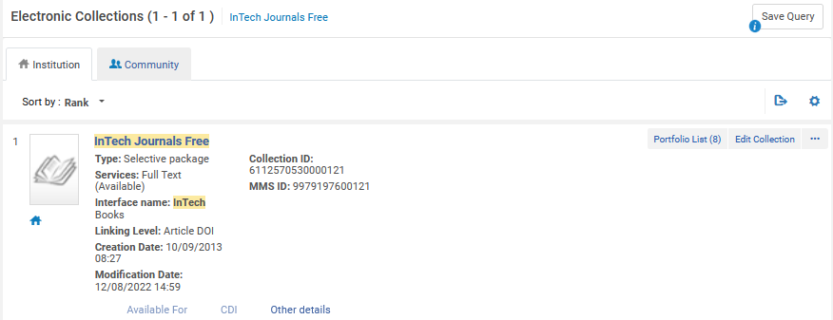
Accessing the Electronic Service Editor “Portfolios” tab
Option 2 – step 1

Slide 16
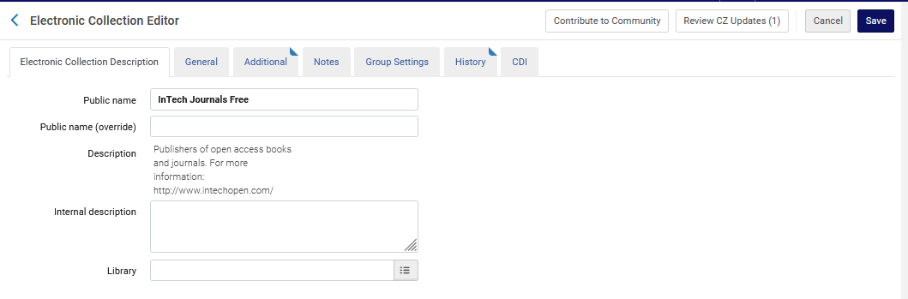
Accessing the Electronic Service Editor “Portfolios” tab
Option 2 – step 2

Slide 17
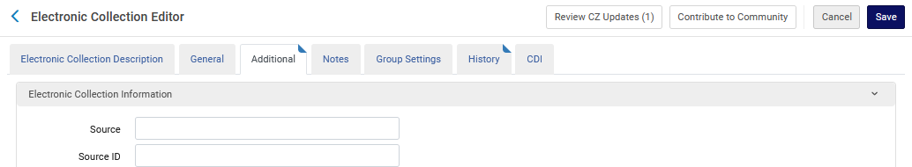
Accessing the Electronic Service Editor “Portfolios” tab
Option 2 – step 3

Slide 18
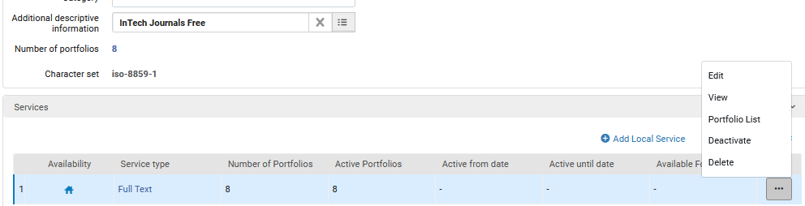
Accessing the Electronic Service Editor “Portfolios” tab
Option 2 – step 4

Slide 19
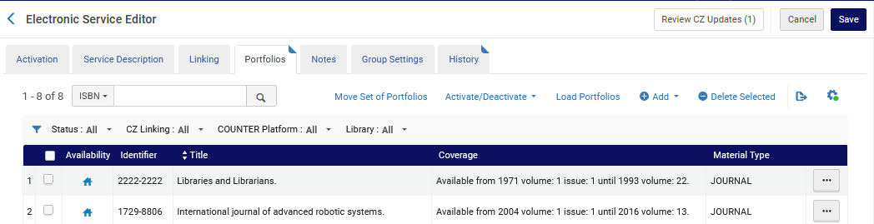
Accessing the Electronic Service Editor “Portfolios” tab
Option 2 – step 5

Slide 20
Using the Electronic Service Editor “Portfolios” tab

Slide 21
Using the Electronic Service Editor “Portfolios” tab
First, we will look at Moving a Set of Portfolios to a Different Electronic Collection.

Slide 22
Using the Electronic Service Editor “Portfolios” tab
In order to move a set of portfolios the staff user should
Identify the current electronic collection in which the portfolios are present (source)
Create a set of the portfolios
Identify the electronic collection to which it is desired to move the portfolios (destination)
The action needs to be done in the source collection (the electronic collection from which the portfolios will be moved).

Slide 23
Using the Electronic Service Editor “Portfolios” tab
In our examples we will move a set of three portfolios from Electronic Collection “BioMed Central Open Access Free” to Electronic Collection “OAPEN Free”
We will move the following portfolios from “BioMed Central Open Access Free” to “OAPEN Free”
  European journal of medical research.
  Marine biodiversity records.
  BMC pharmacology & toxicology.

Slide 24

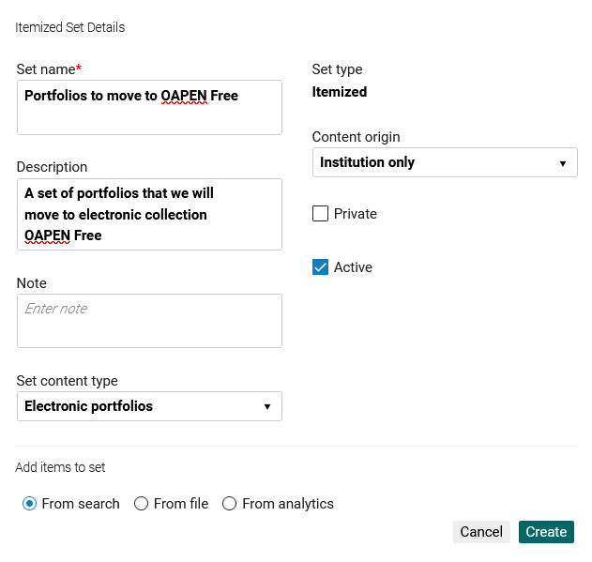
Using the Electronic Service Editor “Portfolios” tab
Create an itemized set of portfolios.
The set content type should be “Electronic portfolios”

Slide 25
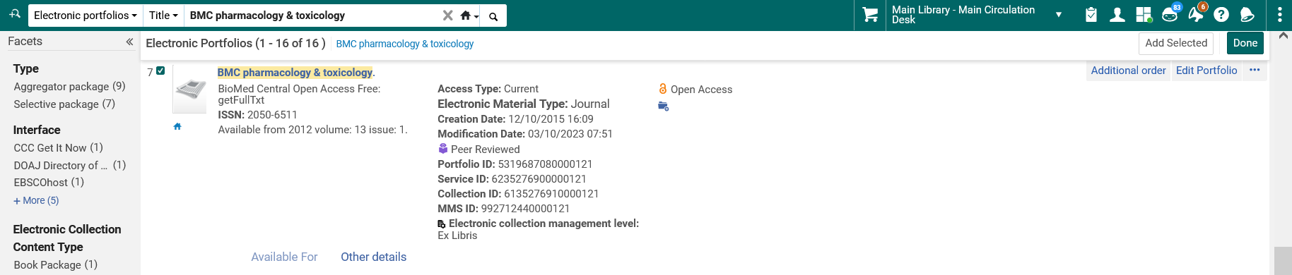
Using the Electronic Service Editor “Portfolios” tab
Begin adding members to the set

Slide 26
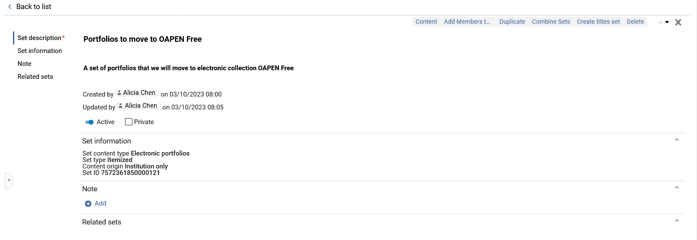
Using the Electronic Service Editor “Portfolios” tab
The set has been created

Slide 27
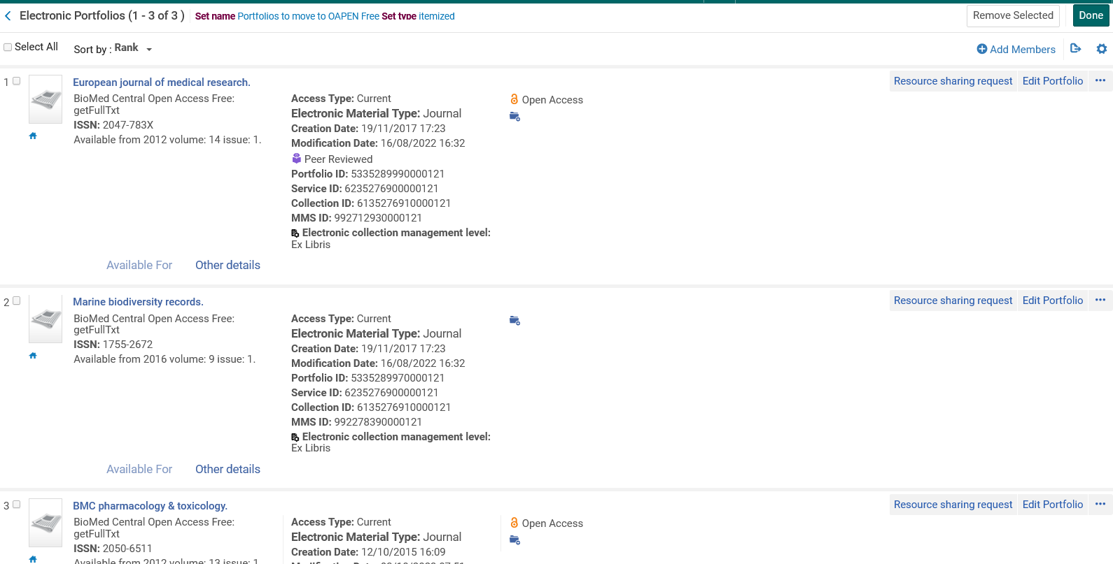
Using the Electronic Service Editor “Portfolios” tab
All three portfolios are in the set
The portfolios are currently in electronic collection “BioMed Central Open Access Free”

Slide 28
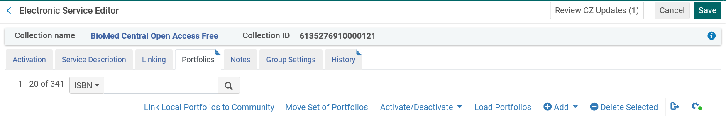
Using the Electronic Service Editor “Portfolios” tab
From the source collection (“BioMed Central Open Access Free”) “Electronic Service Editor” “Portfolios” tab click “Move Set of Portfolios”

Slide 29
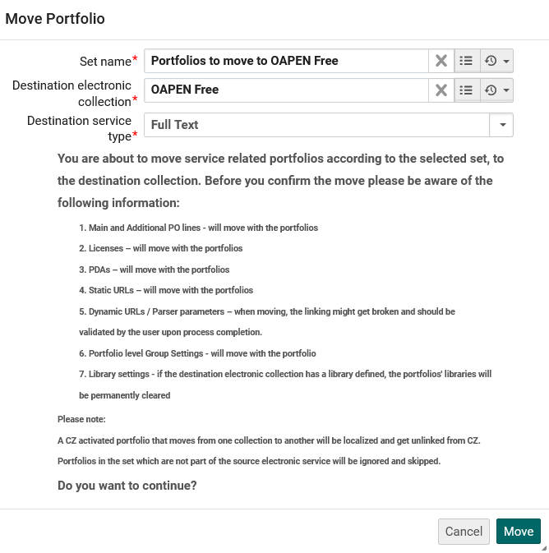
Using the Electronic Service Editor “Portfolios” tab
Fill in the set name, destination Electronic Collection, and click “Move”

Slide 30
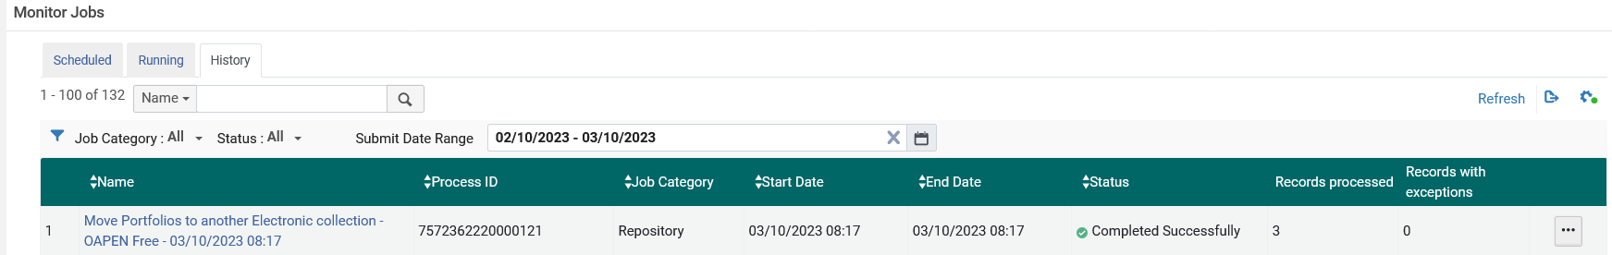
Using the Electronic Service Editor “Portfolios” tab
A job runs to move the portfolios in the set

Slide 31
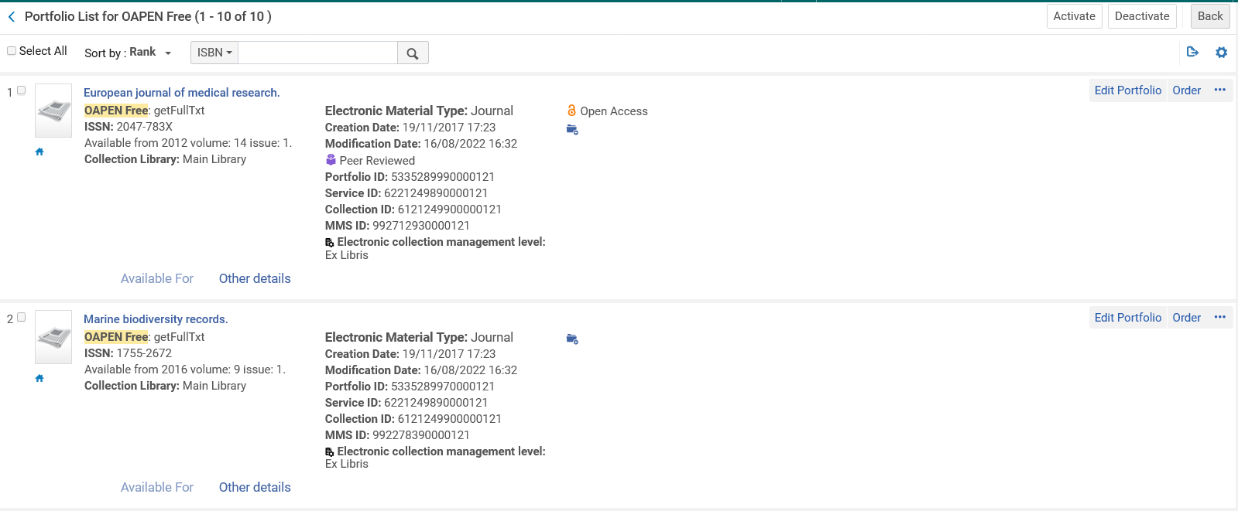
Using the Electronic Service Editor “Portfolios” tab
The portfolios have moved to Electronic Collection “OAPEN Free”
Here are two of the three portfolios which have moved to electronic collection “OAPEN Free”

Slide 32
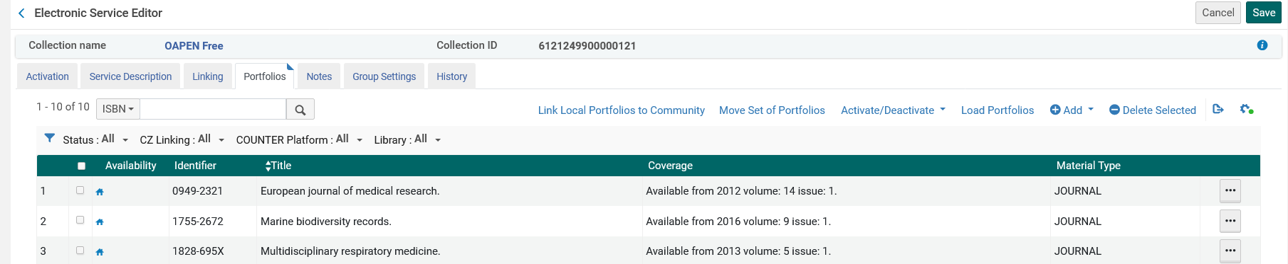
Using the Electronic Service Editor “Portfolios” tab
Now, also from the “Portfolios” tab of the Electronic Service Editor, we will look at “Activate / Deactivate”

Slide 33
Using the Electronic Service Editor “Portfolios” tab
The “activate/deactivate” option allows the staff user to either activate or deactivate multiple resources in batch mode.
Either:
Select “Action Items” (the three dots) for a specific resource
Select “Activate” or “Deactivate” from the options
Or
Select multiple resources via the check boxes
Select “Activate Selected” or “Deactivate Selected” from the drop-down list

Slide 34
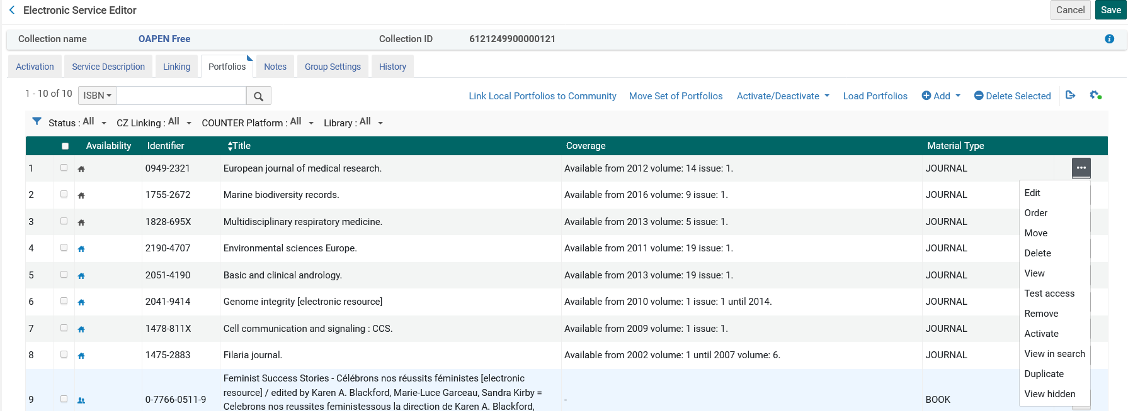
Using the Electronic Service Editor “Portfolios” tab
Select “Action Items” (the three dots) for a specific resource
Select “Activate” or “Deactivate” from the options

Slide 35
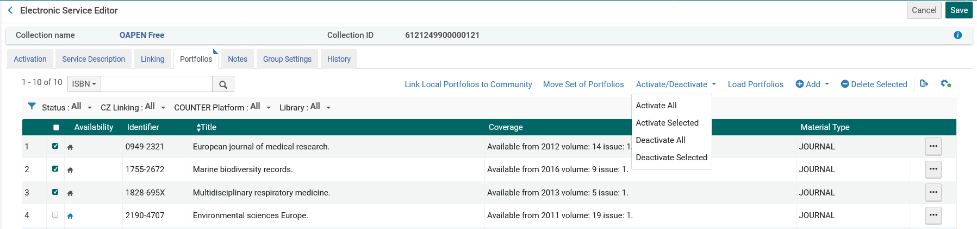
Using the Electronic Service Editor “Portfolios” tab
Select multiple resources via the check boxes
Select “Activate Selected” or “Deactivate Selected” from the drop-down list
This will activate the selected portfolios
Note that currently the icons are grey (not activated)

Slide 36
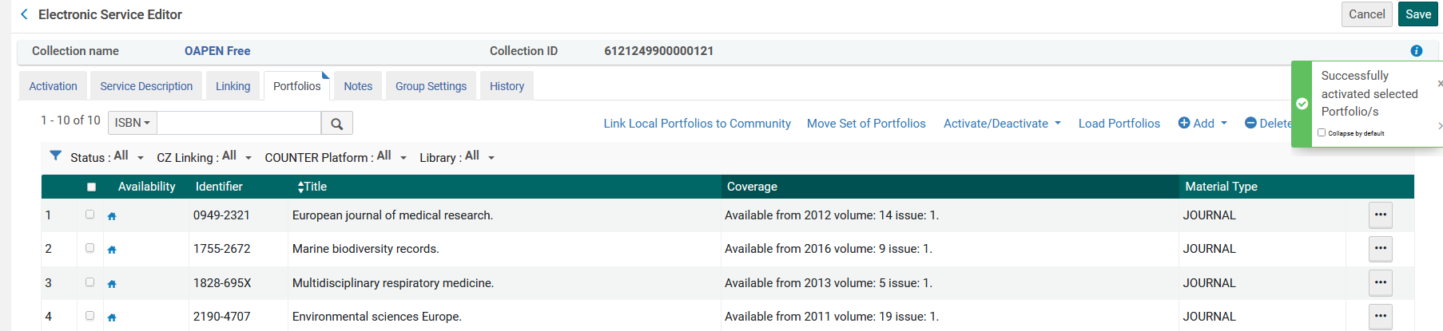
Using the Electronic Service Editor “Portfolios” tab
The portfolios are now activated
Note that the icons are blue (activated)

Slide 37
The portfolio loader

Slide 38
The portfolio loader
The portfolio loader is used perform the following activities in batch mode for portfolios in an electronic collection:
Create new portfolios and add them to the electronic collection
Update existing portfolios in the electronic collection
Delete portfolios from an electronic collection
See also Using Portfolio Loader for Adding, Updating or Removing Portfolio Information in Bulk

Slide 39
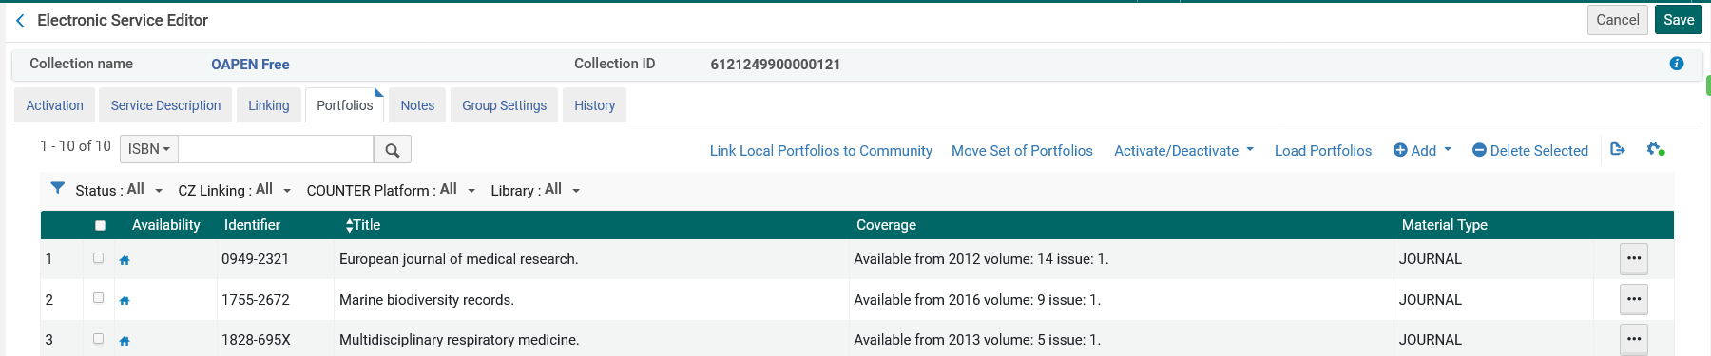
The portfolio loader
The portfolio loader is accessed via the “Load Portfolios” link in the “Portfolios” tab of the “Electronic Service Editor”

Slide 40
The portfolio loader
The batch update is done by using either of the following file types
  An Excel spreadsheet
  A KBART file that contains a list of portfolios.
For information, see Portfolio Loader (Excel file) or Portfolio Loader Support to KBART Files.

Slide 41
Using the portfolio loader to add new portfolios using an Excel sheet

Slide 42
Using the portfolio loader to add new portfolios using an Excel sheet
To add new portfolios, you can use and Excel sheet or a KBART file.
Regarding the Excel sheet:
There is a sample blank Excel sheet linked here - Excel spreadsheet. (It is also linked from the online help at Portfolio Loader)
An Excel sheet like the one exported from the “Portfolios” tab of the Electronic Service Editor using the “Export > Extended Report” can also be used.
Not all fields in the import file need to be filled in
The file in the second method “Export > Extended Report” is identical to the file in the first method, but with a few additional columns that are not part of the Portfolio Loader file/import process.
Both files can be used. The advantage of using the file from the “Export > Extended Report” method is that it contains real examples of how the file should be filled in

Slide 43
Using the portfolio loader to add new portfolios using an Excel sheet
We will now do an example using an Excel sheet like the one exported from the “Portfolios” tab of the Electronic Service Editor using the “Export > Extended Report”.
We will have one portfolio in our Excel sheet, just to show the process.
The same flow is used for multiple portfolios in the Excel sheet.

Slide 44
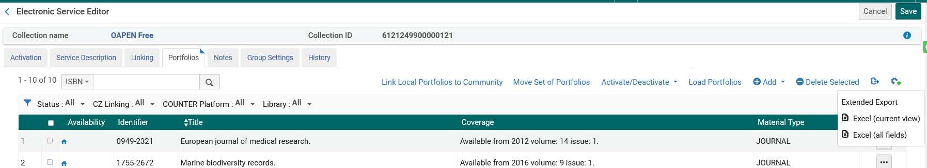
Using the portfolio loader to add new portfolios using an Excel sheet
From the Electronic Service Editor “Portfolios” tab export the extended report

Slide 45
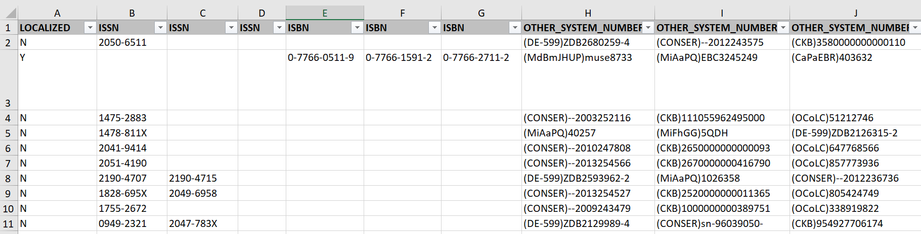
Using the portfolio loader to add new portfolios using an Excel sheet
You will have a file, for example like this (with many more columns than appear in this screenshot).
Typically, such a file will be received from a vendor, or exported from Alma and edited (depending on the need).

Slide 46

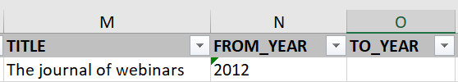

Using the portfolio loader to add new portfolios using an Excel sheet
Add the new title(s) using the existing lines as an example.
Remove existing lines and leave only lines with new portfolios.
Here are parts of the Excel sheet (for one resource) we will import.
We will add a new portfolio called “The journal of webinars”

Slide 47
Using the portfolio loader to add new portfolios using an Excel sheet
Choose “Load Portfolios”

Slide 48
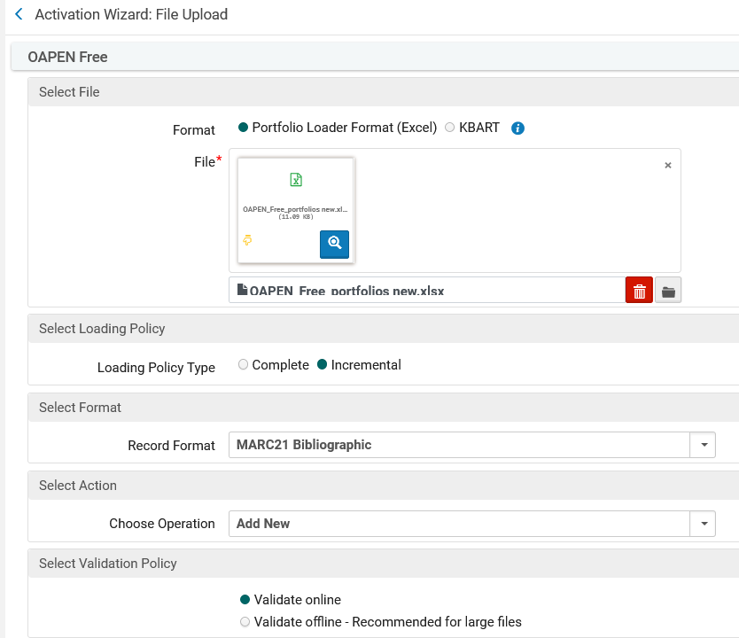

Using the portfolio loader to add new portfolios using an Excel sheet
“This time we are choosing format “Portfolio Loader Format (Excel)”
“Complete” loads a complete set of portfolios, overwriting any existing portfolios.
“Incremental” will make changes to the existing list of portfolios

Slide 49
Using the portfolio loader to add new portfolios using an Excel sheet
For a detailed description of the “Complete” and “Incremental” loading policy types in the portfolio loader:
  see step 4 under “To add, update, or delete multiple portfolios using a batch process” at Using Portfolio Loader for Adding, Updating or Removing Portfolio Information in Bulk

Slide 50
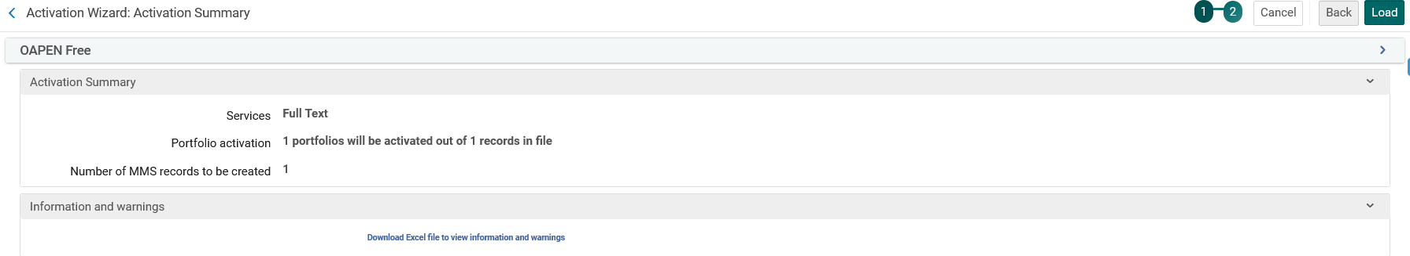
Using the portfolio loader to add new portfolios using an Excel sheet
We will load the file

Slide 51
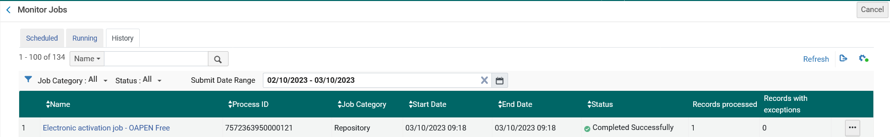
Using the portfolio loader to add new portfolios using an Excel sheet
A job runs and completes

Slide 52
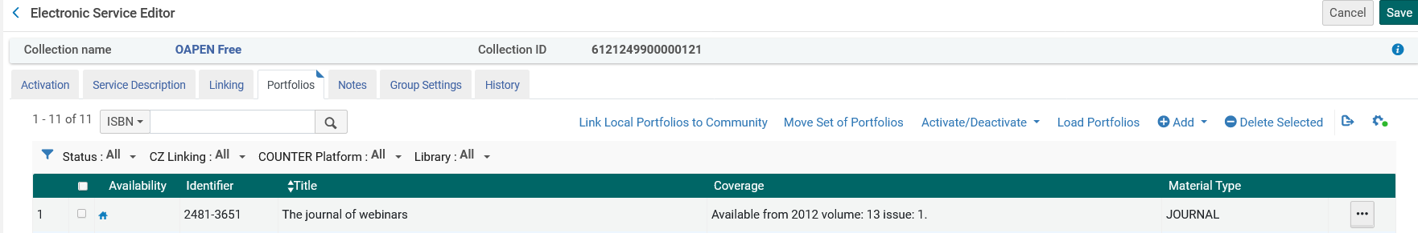
Using the portfolio loader to add new portfolios using an Excel sheet
The new portfolio was added

Slide 53
Using the portfolio loader to update portfolio coverage using a KBART file

Slide 54
Using the portfolio loader to update portfolio coverage using a KBART file
Now we will do an example using a KBART (Knowledge Bases and Related Tools) file.
Typically, a KBART file is received from the vendor.
You can make your own KBART file by using the job “Export Electronic Portfolios” and choosing format “KBART”.

Slide 55

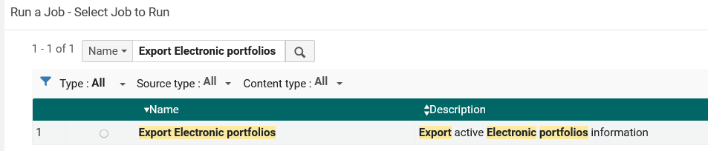
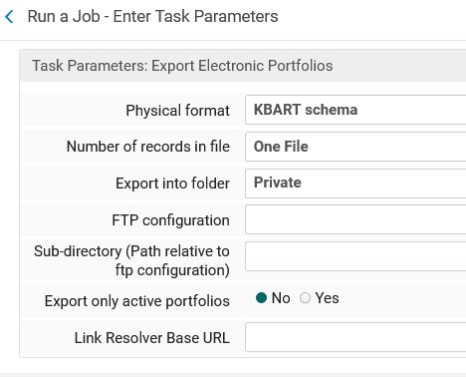
Using the portfolio loader to update portfolio coverage using a KBART file

Slide 56
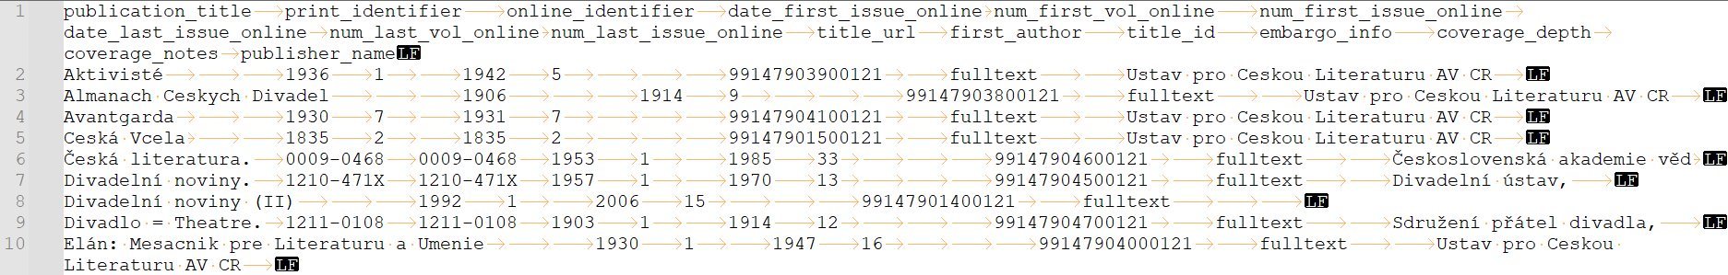
Using the portfolio loader to update portfolio coverage using a KBART file
Here is a sample KBART file exported from Alma viewed in notepad ++ showing all symbols (including tabs and end of lines)

Slide 57
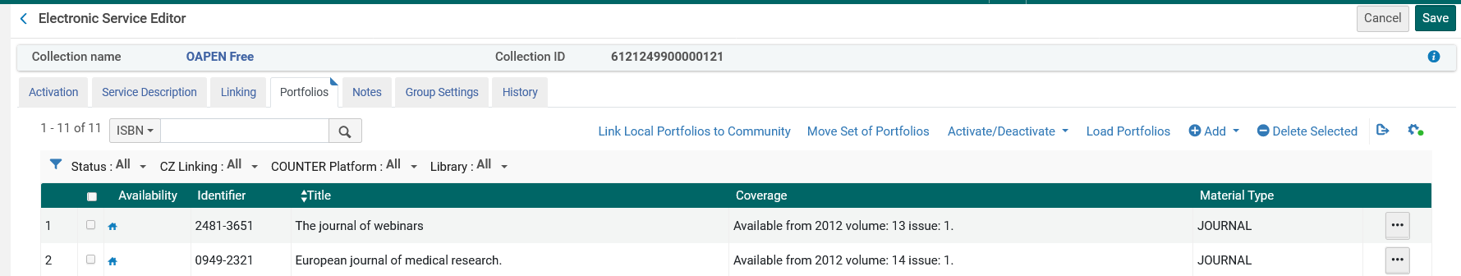
Using the portfolio loader to update portfolio coverage using a KBART file
Our Electronic Collection “OAPEN Free now has 11 active local portfolios
Note (for later) that for these two portfolios “The journal of webinars” and “European journal of medical research” the coverage begins in 2012

Slide 58
Using the portfolio loader to update portfolio coverage using a KBART file
On the next slide we have KBART file sent from the vendor with updates to coverage in existing portfolios
Line 1 is the header.
“The journal of webinars” now begins coverage in 1971 with vol. 1
“European journal of medical research” now begins coverage in 1948 with vol. 1

Slide 59
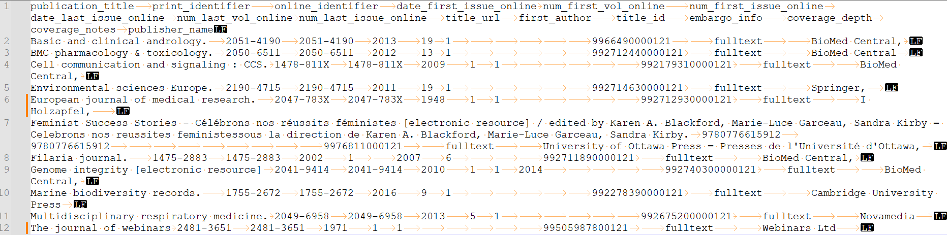
Using the portfolio loader to update portfolio coverage using a KBART file

Slide 60
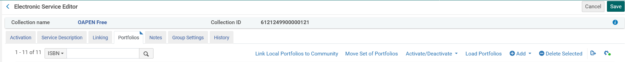
Using the portfolio loader to update portfolio coverage using a KBART file
From the electronic service editor, we will choose “Load Portfolios”

Slide 61
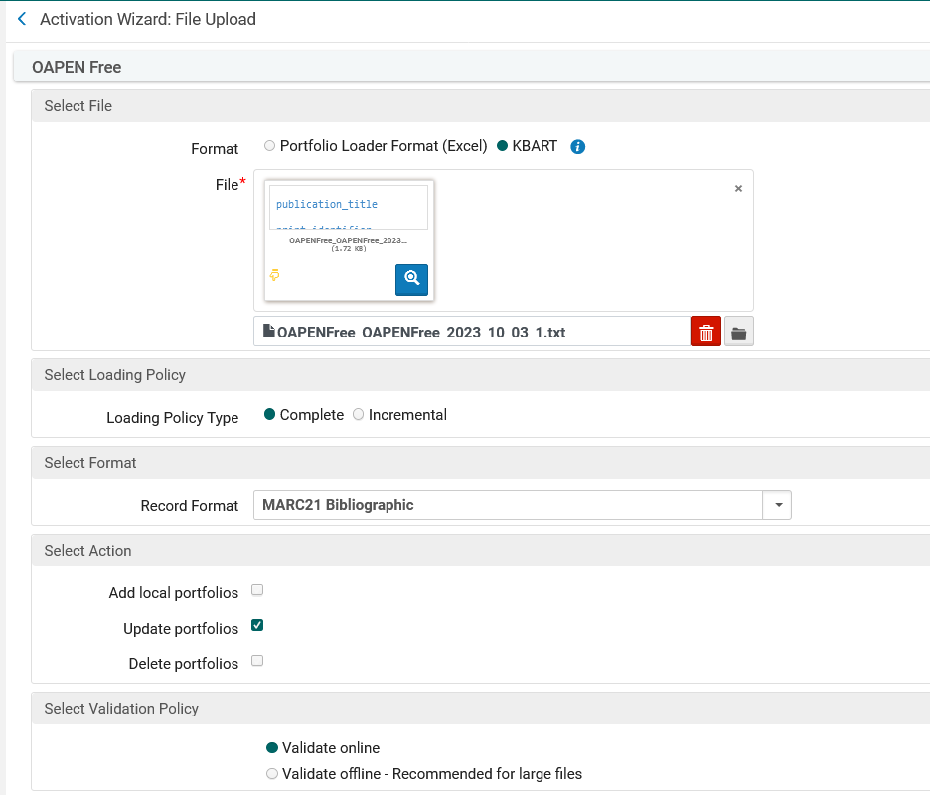
Using the portfolio loader to update portfolio coverage using a KBART file
“This time we are choosing format “KBART”
“Complete” loads a complete set of portfolios, overwriting any existing portfolios.
“Incremental” will make changes to the existing list of portfolios

Slide 62
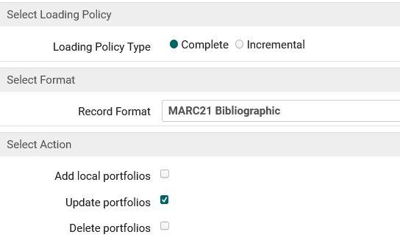
Using the portfolio loader to update portfolio coverage using a KBART file
Note that when we loaded the portfolios we chose
  Loading Policy Type = Complete
  Action = Update portfolios

Slide 63
Using the portfolio loader to update portfolio coverage using a KBART file
For a detailed description of the “Complete” and “Incremental” loading policy types in the portfolio loader:
  see step 4 under “To add, update, or delete multiple portfolios using a batch process” at Using Portfolio Loader for Adding, Updating or Removing Portfolio Information in Bulk

Slide 64
Using the portfolio loader to update portfolio coverage using a KBART file
As explained in step 4 under “To add, update, or delete multiple portfolios using a batch process” at Using Portfolio Loader for Adding, Updating or Removing Portfolio Information in Bulk , this means:
Complete – Loads a complete set of portfolios, overwriting any existing portfolios.
Update portfolios – Update existing local portfolios with the information listed in the Excel or KBART file for the matching portfolios when this option is selected. For portfolios linked to the Community Zone, only parser parameters and coverage information is updated when this option is selected.

Slide 65
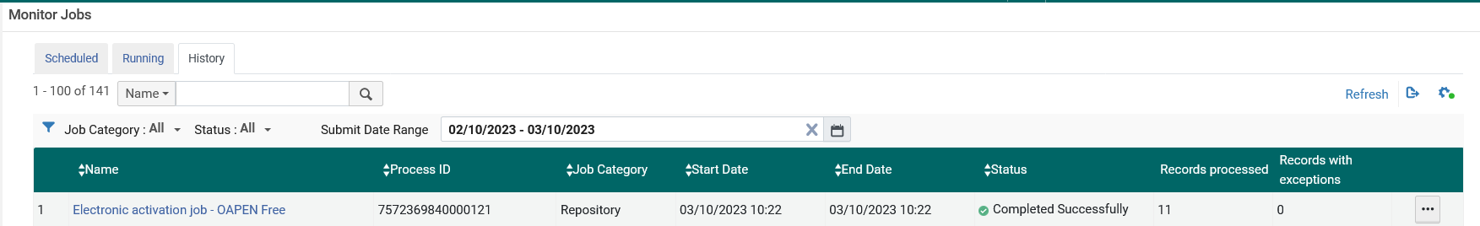
Using the portfolio loader to update portfolio coverage using a KBART file
The job runs to update the portfolios

Slide 66
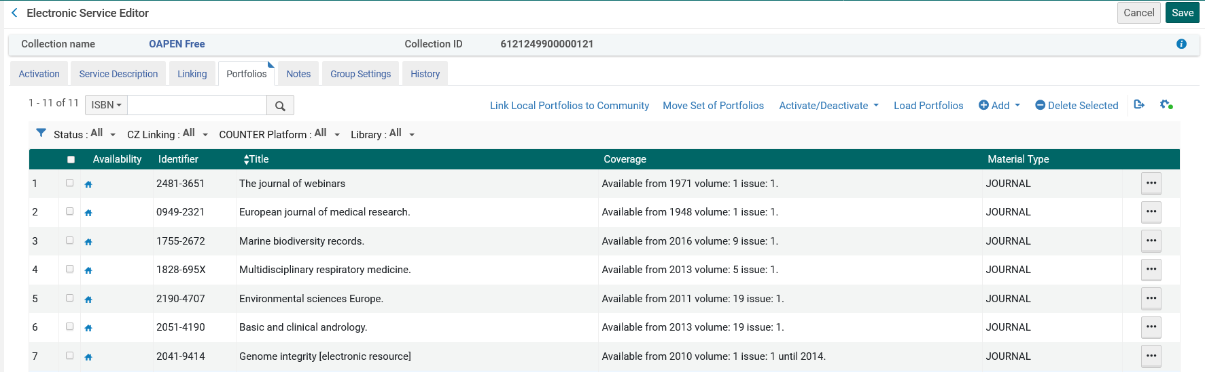
Using the portfolio loader to update portfolio coverage using a KBART file
The list of portfolios is now according to the input file
As per the KBART input file “The journal of webinars” now begins coverage in 1971 with vol. 1.
“European journal of medical research” now begins coverage in 1948 with vol. 1

Slide 67
The job “Change electronic portfolio information”

Slide 68
The job “Change electronic portfolio information”
The job “Change electronic portfolio information” allows the institution to perform global changes on a set of portfolios.
For more information, see Performing Global Changes on Portfolios Using a Job.
In our example we can search for all portfolios which are part of electronic collection “InTech Journals Free” and save the query as a set.

Slide 69
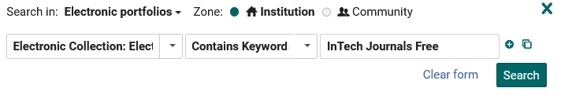
The job “Change electronic portfolio information”
Creating the set of portfolios - search

Slide 70
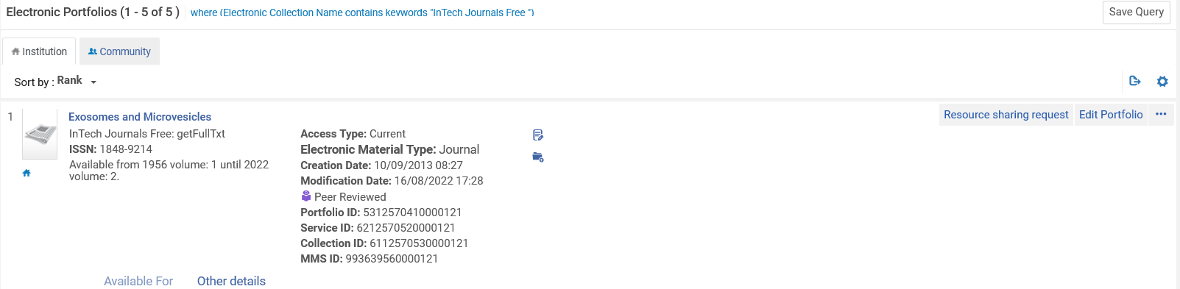
The job “Change electronic portfolio information”
Creating the set - save

Slide 71
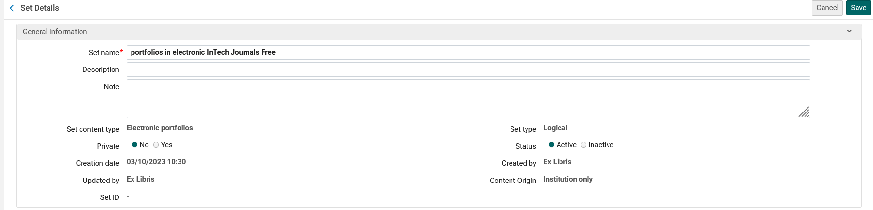
The job “Change electronic portfolio information”
Creating the set - saving

Slide 72
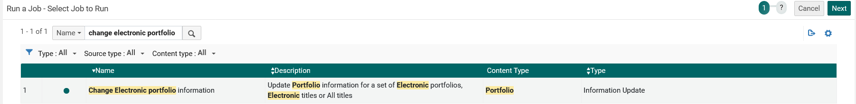
The job “Change electronic portfolio information”
Access the job via “Admin > Manage Jobs and Sets > Run a Job”

Slide 73
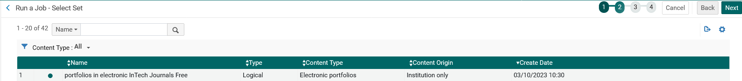
The job “Change electronic portfolio information”
Choose the set

Slide 74
The job “Change electronic portfolio information”
In the job we have added a public note

Slide 75
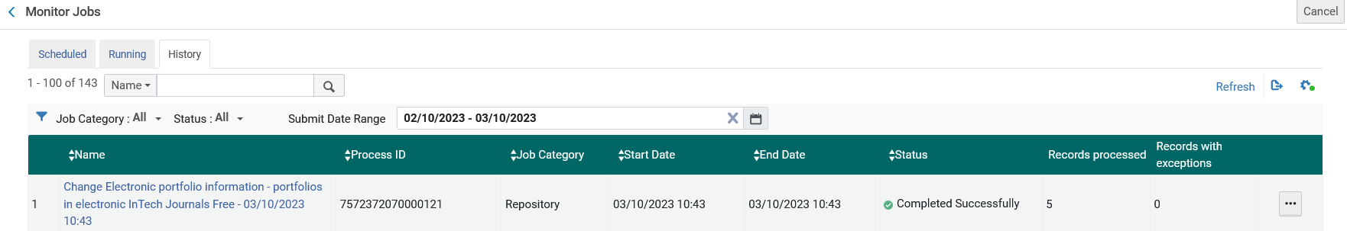
The job “Change electronic portfolio information”
The job runs and completes

Slide 76
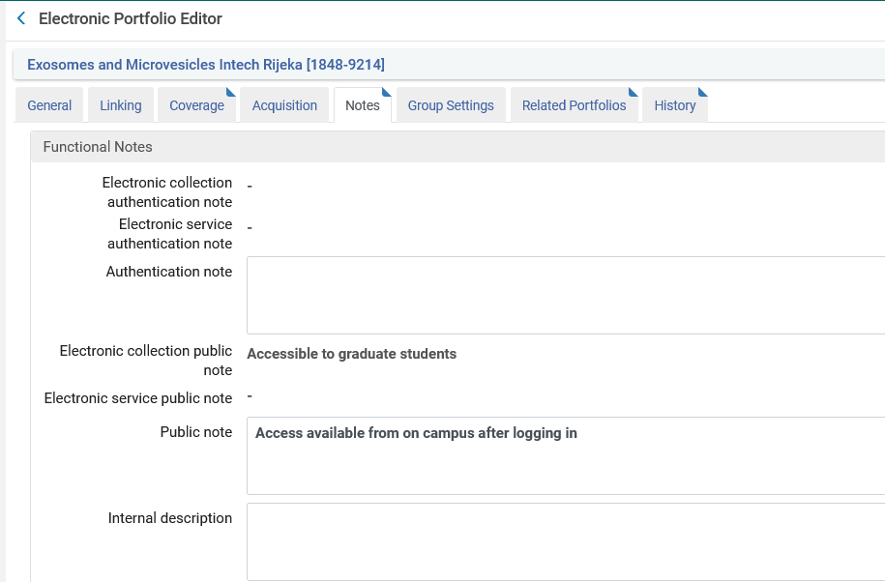
The job “Change electronic portfolio information”
The public note has been added to all portfolios

Slide 77
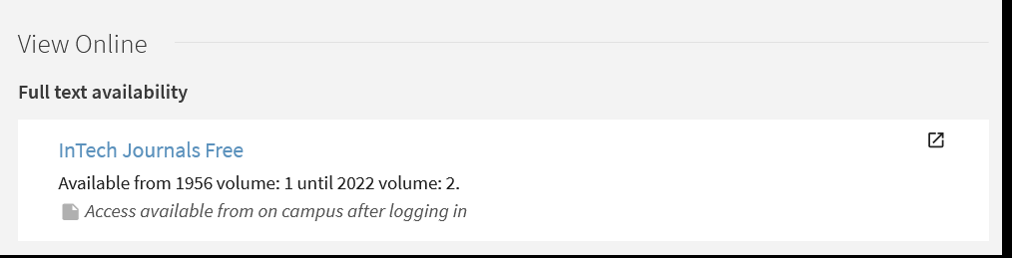
The job “Change electronic portfolio information”
Here we see the public note in discovery

Slide 78
xxx@exlibrisgroup.com

